Slide 1
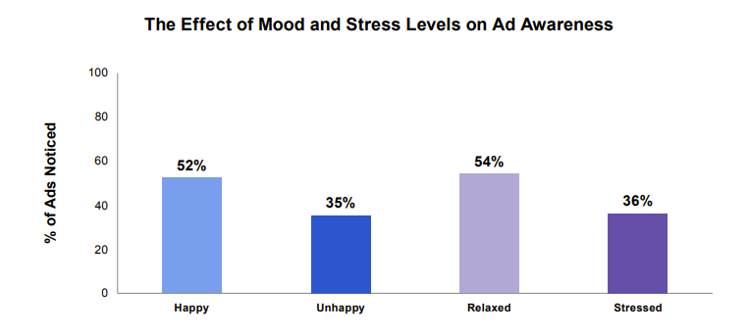
Ads are more noticed when people are relaxed and/or in a good mood
Source: Bronner (2007), reported by Richard Shotton (The Value of TV: A Behavioural Science Perspective, 2024)
Notes:
This chart features in Richard Shotton’s recent ‘The Value of TV: A Behavioural Science Perspective’. It shows how reaching people during positive moments increases the likelihood of an ad being noticed.
The chart is from a study by Fred Bronner, a professor of advertising at the University of Amsterdam. Bronner asked 1,287 participants to flick through a newspaper and then answer questions about the ads they remembered.
This data was then split by reader’s mood, with results showing that those who were happy recalled 52% of ads, whereas those who were unhappy noticed just 35%. Additionally, stress levels were also important as relaxed participants noticed 54% of ads whereas those who were stressed remembered just 36%.
This shows…well, it’s pretty obvious what it shows, but we’ll spell it out anyway: there’s huge potential in targeting consumers’ moods.
For more information on the behavioural science perspective of the value of TV, download the report here: https://www.thinkbox.tv/research/reports/the-value-of-tv-a-behavioural-science-perspective

