Slide 1
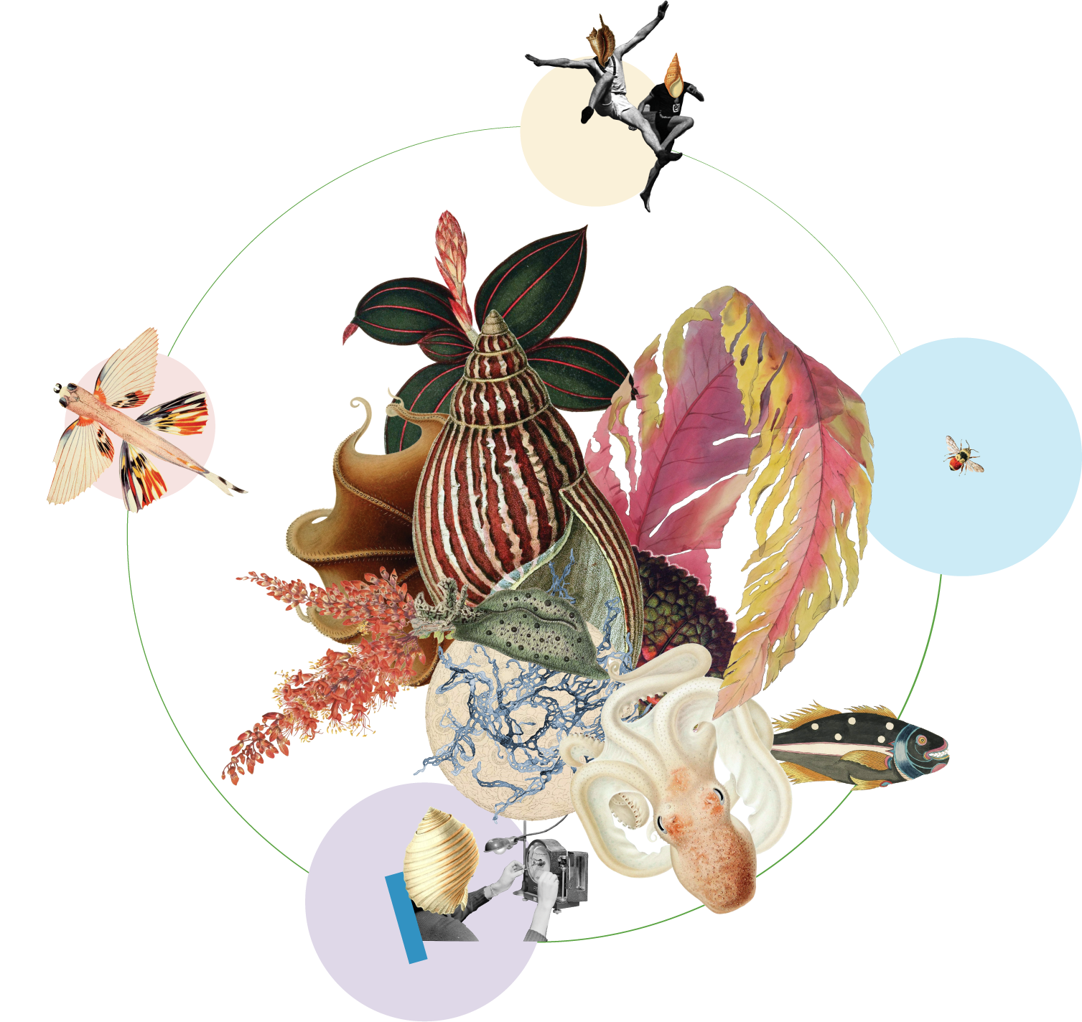

Slide 2
Vision

Slide 3
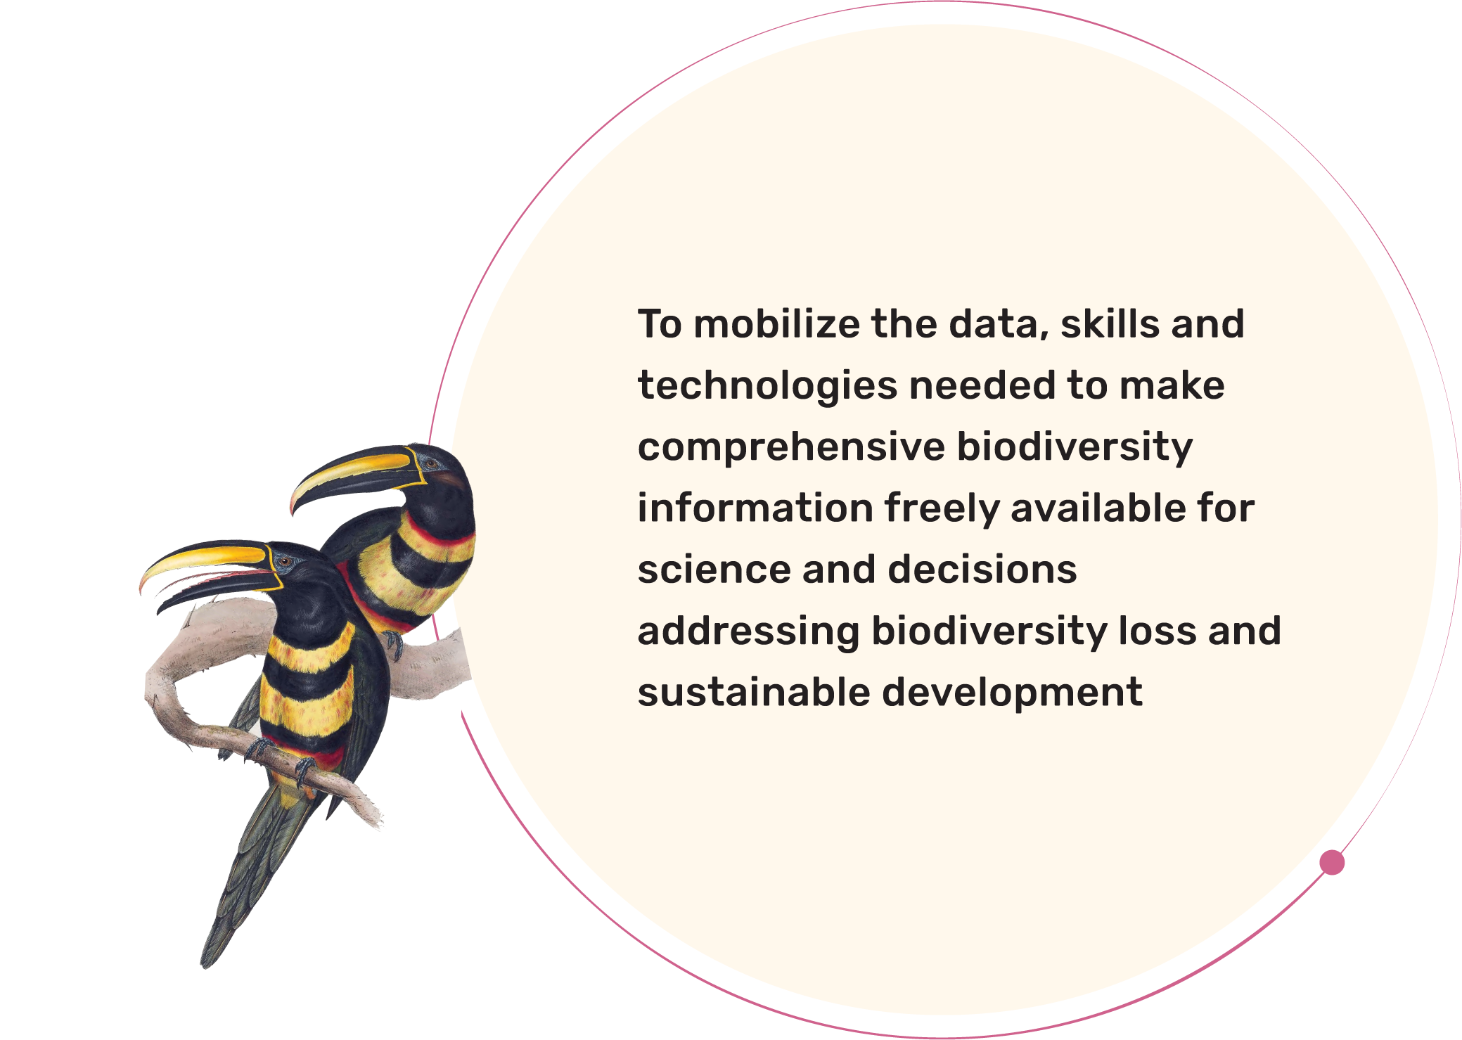
Mission

Slide 4
Values that apply to the Secretariat, to the global nodes network, to participants, to data publishing institutions, and to data users, that together embody the global GBIF community.

Slide 5
Trust and Transparency: Expectations that all decisions and processes are open; that data is properly attributed and of the highest-possible quality; and that infrastructures are robust, documented and persistent
Collaboration and Collective Benefit: A recognition that only through a spirit of cooperation can we fulfil GBIF’s mission by sharing skills, data, tools and experiences, avoiding duplication, and growing a global community of practice
Diversity and Inclusiveness: A commitment to engage and welcome people of all nationalities, cultures, genders and backgrounds while recognizing all contributions to our global community
Innovation: An ambition to lead by example in advancing open science and data services and in adopting novel techniques for collaboration and learning, recognizing that simplicity is often the best means of reaching our goals
Integrity: An assurance that professional norms and scientific integrity are respected; and that data-sharing safeguards the rights of indigenous peoples and local communities as well as potential risks to sensitive species
Values

Slide 7
Building the evidence
to advance scientific research
and understanding of global biodiversity
Objectives
Reduce knowledge gaps by helping the network to set targets for consolidating data coverage across thematic, taxonomic, phylogenetic, spatial and temporal dimensions.
Enable, expand and diversify the uptake and application of GBIF-mediated data.
Support the evolution of fundamental data-driven biodiversity research and its application across methods, scales and disciplines in life and environmental sciences.
Ensure meaningful data exchange and reuse of data through citations and measurements, promoting and consistently applying accepted standards that adhere to best practices and sustain the highest aspirations in open and data-intensive science.
Increase GBIF’s relevance to research, promote recognition, expand involvement and improve best practices for data in academia and higher education.

Slide 8
Supporting policy responses and knowledge
transfer that address urgent societal challenges
around planetary change
Objectives
Develop high-impact programmes that frame themes related to the biodiversity data needs for key societal challenges, including biodiversity loss, climate change, food security and human health.
Strengthen capacity for use of data to contribute to local, national, regional and global biodiversity-related goals, joining with partners to support application of data in policy-relevant information tools and products.
Work with intergovernmental policy partners to provide decision-makers with a more complete global view of biodiversity status and trends, including the use of GBIF-mediated data to generate indicators and to track essential biodiversity variables.
Enhance GBIF’s relevance to policy and decision-makers by creating and maintaining deeper collaborative engagement, through multilateral environmental agreements, UN agencies and science-policy platforms.
Refine messaging to help GBIF target and engage with a wider range of stakeholders.

Slide 9
Enabling the network to meet
future needs and challenges
Objectives
Ensure that GBIF nodes provide a strong and stable foundation for data mobilization and use through the network.
Increase national participation while strengthening engagement of existing voting participants, including in GBIF governance and decision-making.
Develop solutions that increase meaningful participation in the GBIF community by reducing linguistic barriers and providing capacity development and programme support.
Maximize GBIF’s impact by pursuing collaborations across a growing community of partners.
Foster greater openness and transparency through distributed open-source development of shared infrastructure, targeted campaigns for data mobilization and data use, and joint public and private partnerships.
Leverage and diversify funding sources to direct financial support toward strategic growth, especially in biodiversity-rich areas, while maintaining core funding through voting participants.

Slide 10
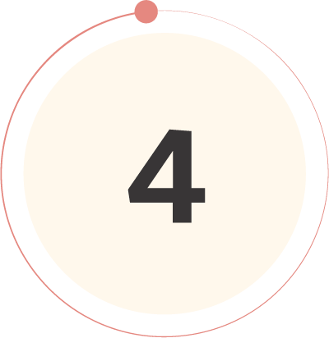
Driving innovation to advance
biodiversity-related knowledge
Objectives
Sustain and improve a robust, environmentally responsible technical infrastructure capable of providing the most accurate, up-to-date, interoperable and reusable data available.
Evolve and adapt data standards and models to enable routine generation of increasingly complex, integrated and comprehensive biodiversity data.
Improve data quality by ensuring rapid, efficient identification and resolution of errors and issues.
Strive toward operating a real-time biodiversity monitoring infrastructure that reduces barriers and delays to integrating current data.
Use the convening power of GBIF to continue to drive the coordination and advancement of the global biodiversity informatics community.

